Slide 1

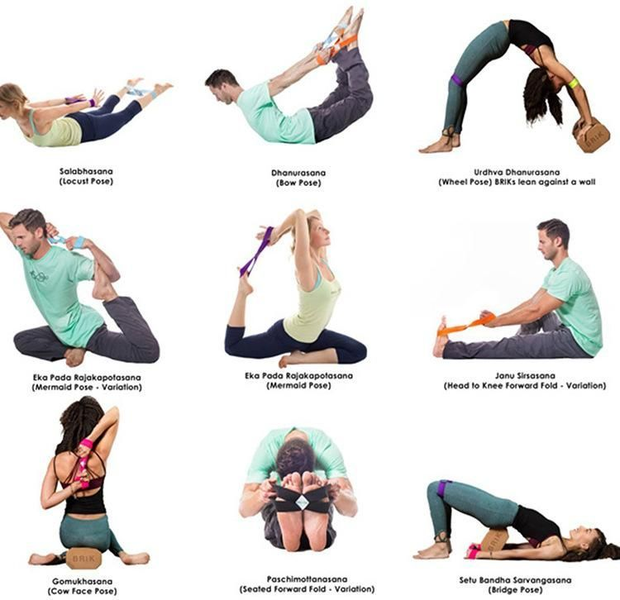
Yoga Pose
Classifier
A Convolutional Neural Network model that can classify different yoga poses from images
Sam Tran, Tony Hoang, Thomas Duffy and Jiffar Abakoyas
Deep Neural Networks & Applications with Tensorflow - Spring 2020

Slide 2
Outline
Project Overview
Models
Results
Team Contributions

Slide 3
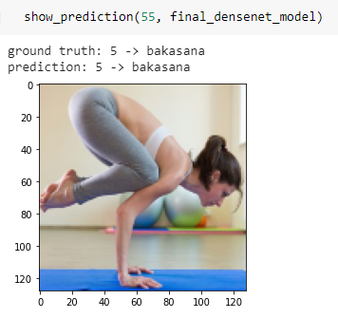
Our purpose
“Ability to classify yoga pose from images by using a CNN and achieve an accuracy better than a random guess ”
Pose estimation of humans from images is becoming more developed with the help of computer vision. Although there are a lot of its applications in fields such as animation, choreography, virtual reality, Yoga is an area that seems to be underexplored. Our goal for this project is to explore the use of Convolutional Neural Network to classify images of yoga pose that can achieve an accuracy better than a random guess

Slide 4
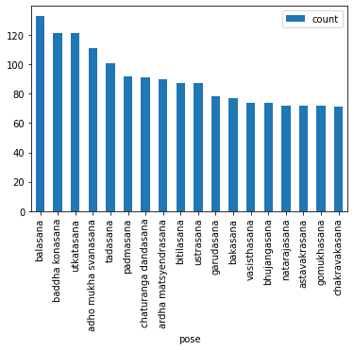
Data & Features
1
Our dataset contains 1298 images of the 17 most common poses in the dataset provided by Oregon States University. We reduce the size of the dataset in order to train our model faster. The original dataset has approximately 6000 images and 107 different yoga poses.

Slide 5
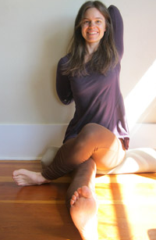
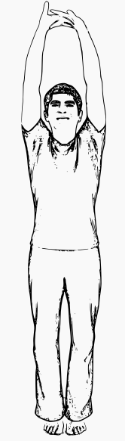
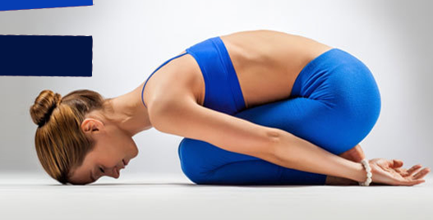

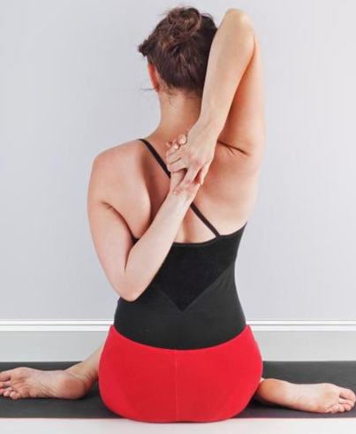
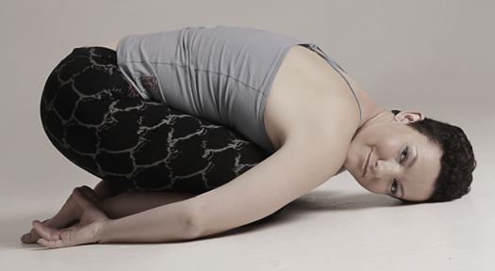
Data samples
Balasana
Tasadan
Gomukhasana

Slide 6
Data Preprocessing
Our data is stored on Google Drive in order to access it easier from Colab notebook
Data partition:
Training: 60%
Validation: 20%
Testing: 20%
Data augmentation:
Rescale
Rotation
Horizontal + Vertical flip
Zoom
Shifting

Slide 7
Models & Results
General approach:
Start with a simple CNN to establish a baseline. Identify areas of improvements and fine-tune it before moving onto more complex structure.
Implement transfer learning models to see whether there’s an improvement in performance

Slide 8
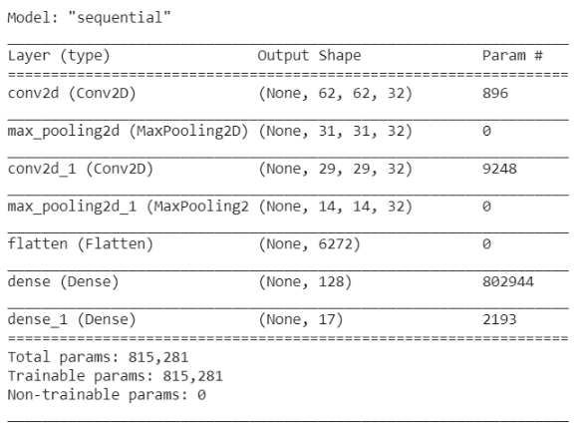
Model 1: Basic CNN
Architecture
Architecture [ graph here if possible] Link
Two convolutional layers
This is the baseline model to gauge the performance

Slide 9
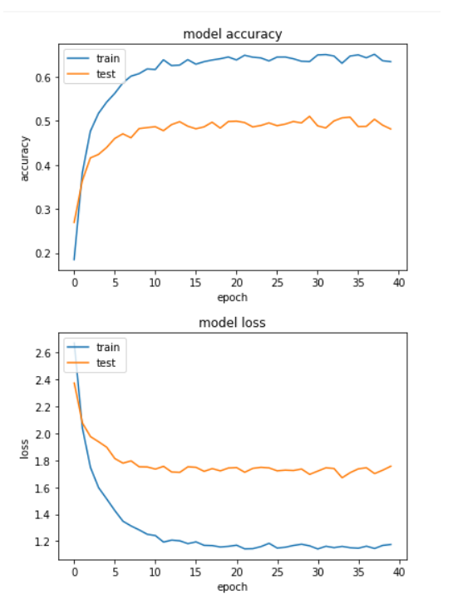
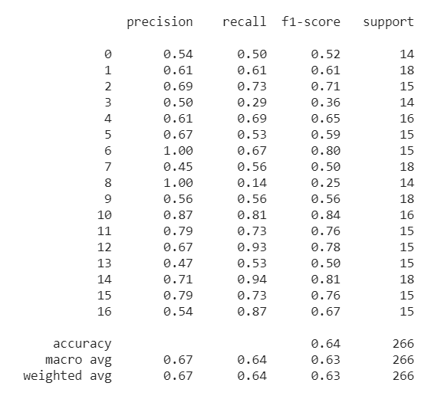
Simple CNN (Baseline)
Model Accuracy: 50%
Notes:
Discussion:

Slide 10
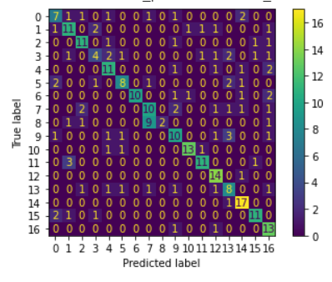
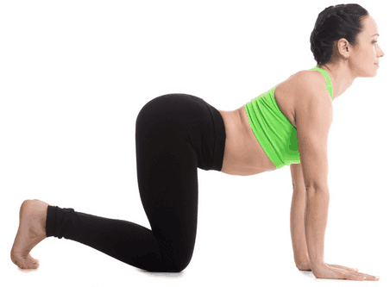
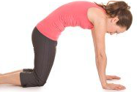
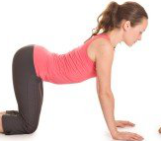
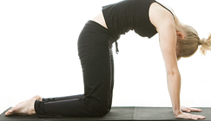
Model 1: Results discussion
Initially overfit despite having high precision & recall, which was due to small test size
Utilize learning rate schedule to prevent model from overfitting too early and growing exponentially -> longer training (epochs = 40)
Problem in dataset: similarities between poses

Slide 11
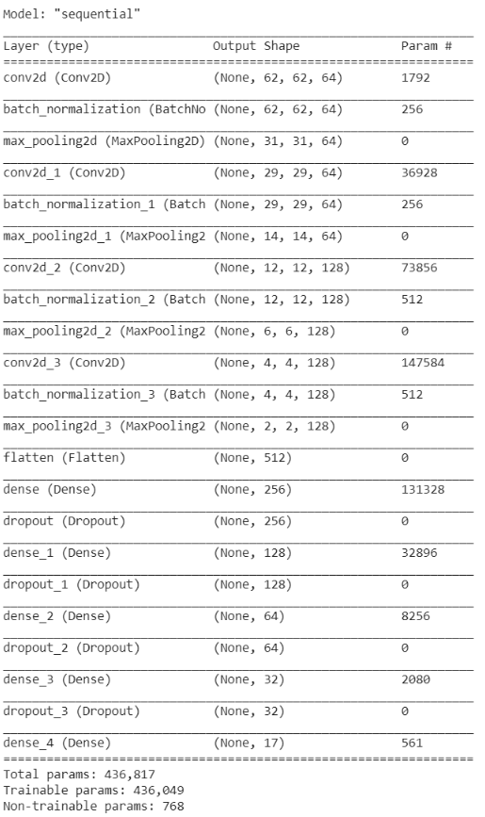
Model 2: Complex CNN
Architecture
Additional Conv2D + Dropout for Dense Layers
Increased learning rate and decreased decaying speed
Notes:
Note: If you are wondering why the validation metrics are clearly better than the training metrics, the main factor is because layers like tf.keras.layers.BatchNormalization and tf.keras.layers.Dropout affect accuracy during training. They are turned off when calculating validation loss

Slide 12
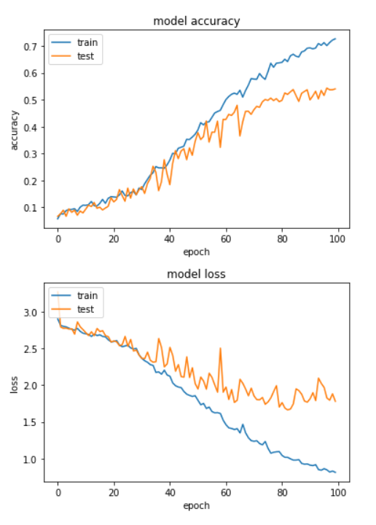
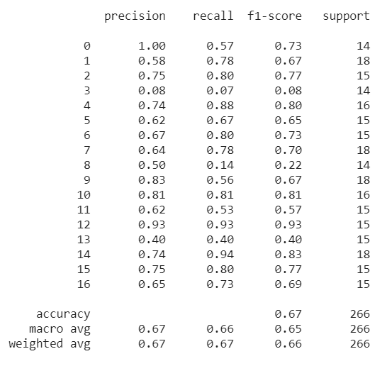
Complex CNN
Model Accuracy: 60%
Notes:
Discussion:

Slide 13
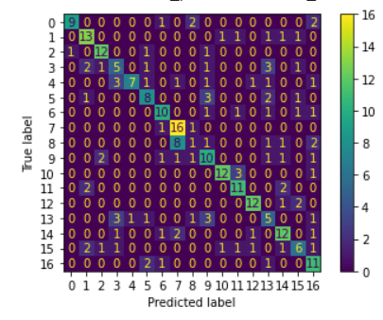
Model 2: Results discussion
Better accuracy & less overfitted than model 1
Accuracy reaching ~60%
Precision & recall?
Impact of dropout layers
Dataset problem is still problematic

Slide 14
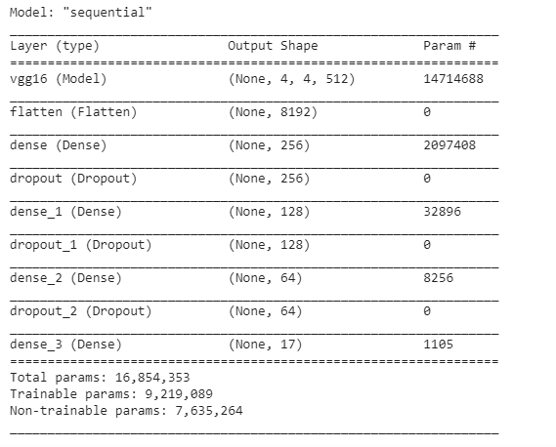
Model 3: Transfer learning w VGG16
Architecture
Unfreeze the last 3 layers of VGG16 and train with the classifiers after pre-training once
Any notes?
“Does transfer learning has a superior performance?”

Slide 15
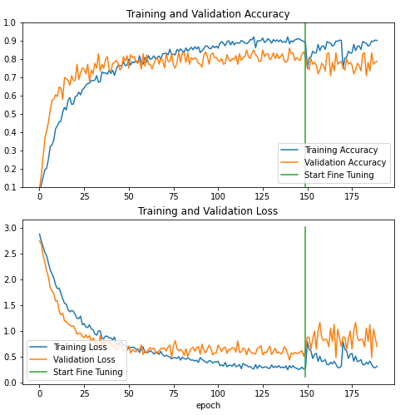
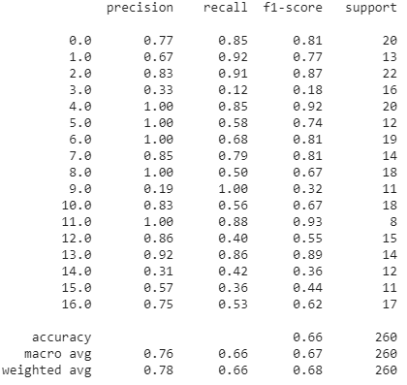
Transfer learning (VGG16)
Model Accuracy: 80%
Notes:
Discussion:

Slide 16
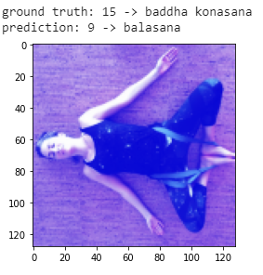
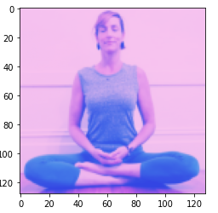
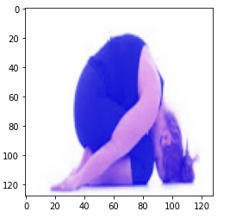
Model 3: Results discussion
Increase in accuracy to 80%
Small training sample -> Overlearning
Performance after fine-tuning vs pre-trained: not much improvement
Precision is good overall, except for a few classes (3, 9 , 14)
Predicting a bunch of other classes as class 9 (Balasana)
Dataset is still problematic: similarities between poses
Class 15: Baddha konasana
Class 9: Balasana
Class prediction

Slide 17
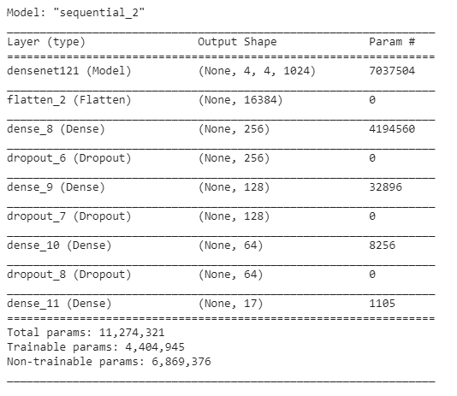
Model 4: Transfer learning w/ DenseNet
Architecture [ graph here if possible] Link
Same classifier architecture as VGG16
Assumptions:
DenseNet might have a better performance than VGG16

Slide 18
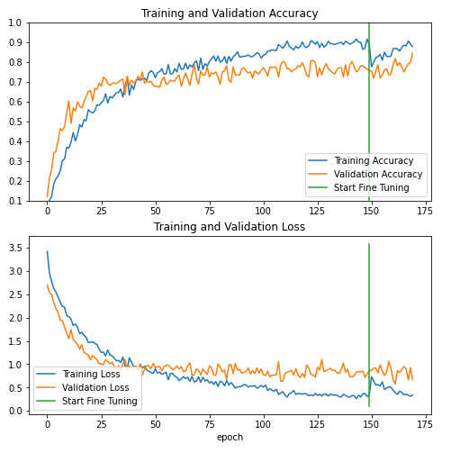
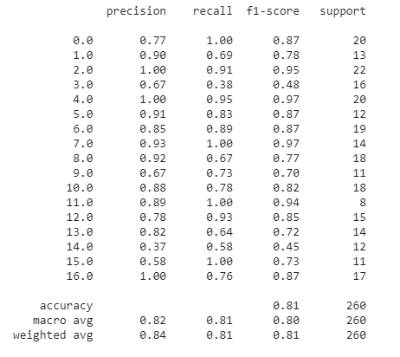
Transfer learning (DenseNet)
Model Accuracy: 80%
Notes:
Discussion:

Slide 19
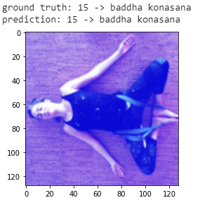
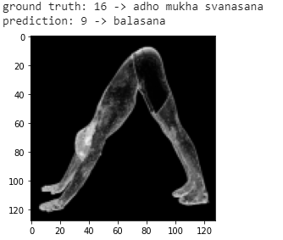
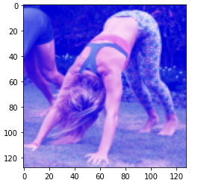
Model 4: Results discussion
Achieved a similar accuracy rate with VGG16, except fine-tuning seems to help with model performance
Elaborate? (ResNet vs VGG16)
Much better precision for classes (3 & 9) that VGG16 has most trouble with
Less mistaken other class with class 9
Dataset problem: pose similarities is still a challenge
CORRECT
WRONG
Class 16: Adho mukha svanasana

Slide 20
Results summary
A basic CNN model can achieve an accuracy better than a random guess
Transfer learning helps with model performance
Main challenge is in the dataset:
Small training data
Pose similarities

Slide 21
Team Contributions

Slide 22
Timeline
MAY
JUN
TODAY
AUG
SEPT
OCT
NOV
Requirements gathering
User research
Wireframes
Review
Prototype
User testing
Dev hand-off

Slide 23
Questions?

Slide 24
References
Tips for Presenting Your Wireframes
3 Steps to Better UI Wireframes
Wireframing for Beginners

Slide 25
Simple Convolution model
Flatten
(6272)
Conv 2D (32)
Conv 2D (32)
Max Pool (2x2)
Max Pool (2x2)
Dense (128)
Dense (17)

Slide 26
Complex Convolution model
17
Legend
Convolution
Batch Normalization
Max Pooling
Flatten
Dropout
Dense

Slide 27
Transfer Learning with Densnet
Densnet
17
Legend
Densenet
Flatten
Dropout
Dense

Slide 28
Transfer Learning with VGG
VGG
17
Legend
VGG
Flatten
Dropout
Dense

